Slide 1
Frog Life Cycle
www.ecosystemforkids.com

Slide 2
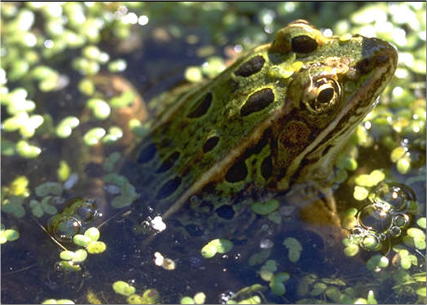
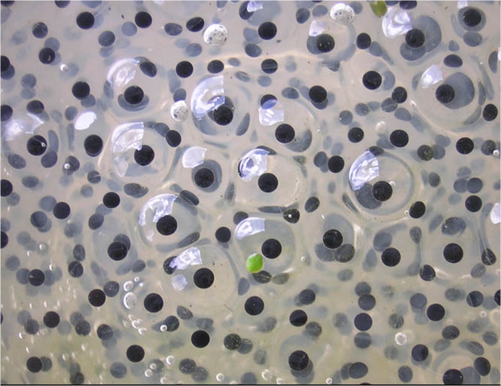
First
Frog Spawn
What are they ?
A female frog lays thousands of eggs under water
During the process they are being fertilized by a male frog
The eggs later float as a jelly-like mass at the surface of ponds
This happens a lot in spring

Slide 3
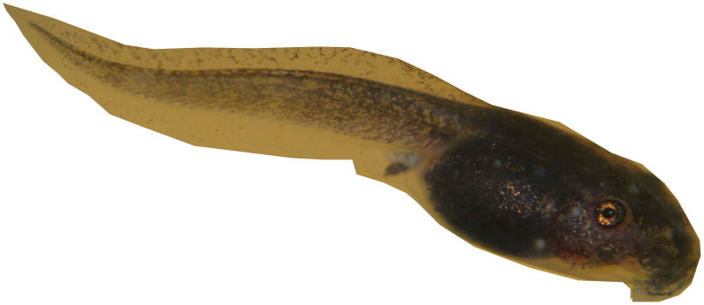
Next
What happens at this stage ?
Tadpole
Between 6 to 21 days after eggs were fertilized, tadpoles hatch from them
They will stay as tadpoles for 6 to 9 weeks depending on the species
Tadpoles live in calm static waters
They feed on algae and micro plants.
Have a tail and swim really fast

Slide 4
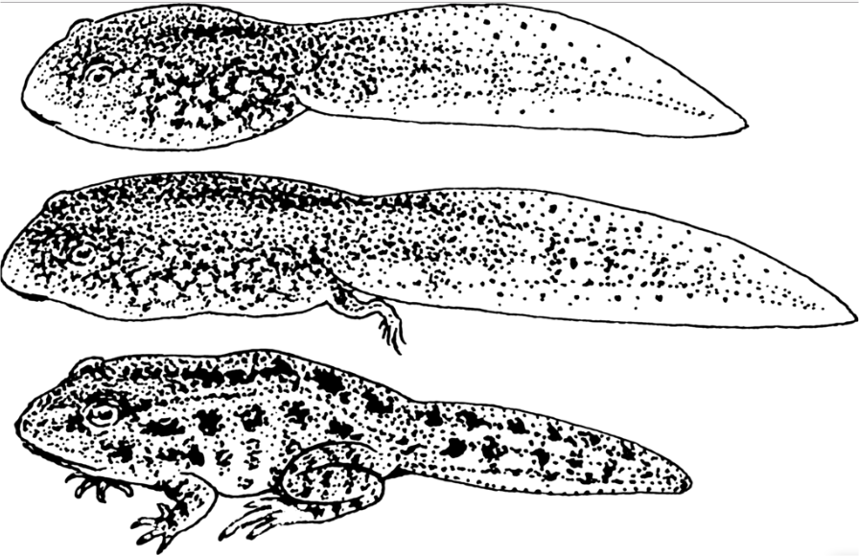
Next
Tadpole
What happens at this stage ?
Tadpole metamorphoses
Develops hind legs first
Later develops forelegs
It looks more like a frog with a tail
The tail starts to shorten. It is also called a froglet at this stage.

Slide 5
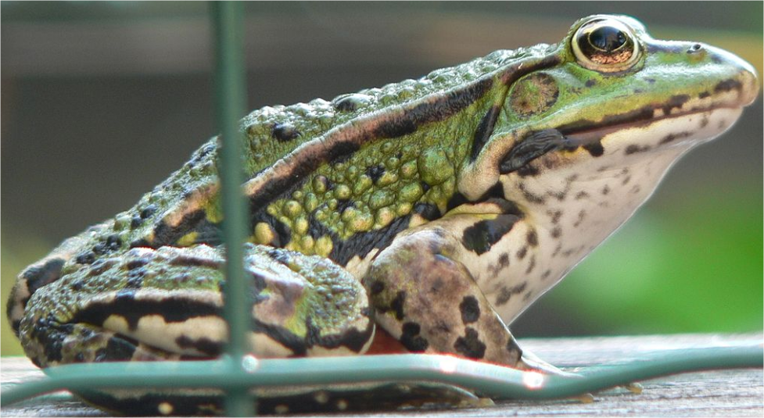
Finally
Adult Frog
What happens at this stage ?
The frog loses its tail and becomes an adult male or female frog.
Being an amphibian, it lives partly on land and in water
Its diet also changes; frogs eat insects.

Slide 6
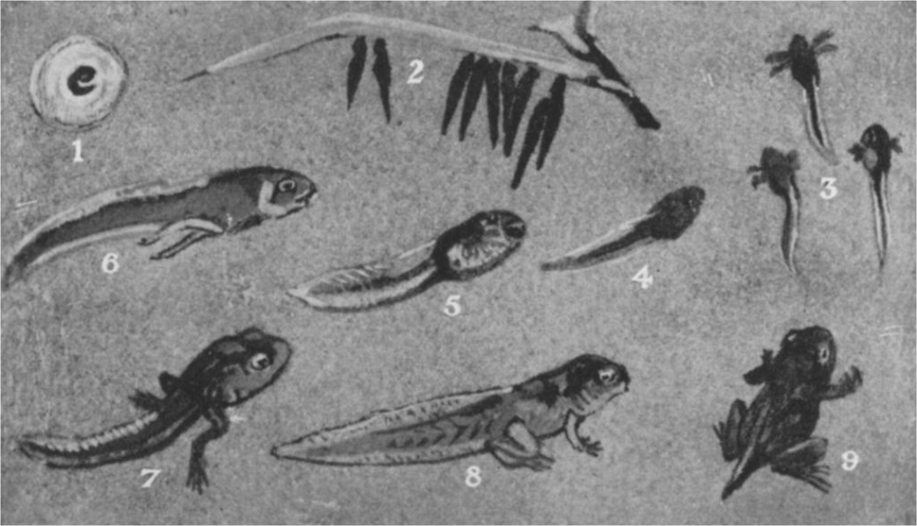
Summary of a frog’s lifecycle

Slide 7
For more FREE ppt lessons visit: www.ecosystemforkids.com
Source of images: Wikipedia images

